Slide 1
Accounting & Market Changes Impacting Mining Companies KY PEM Seminar William J. Kohm, CPA Audit Director September 6, 2013

Slide 2
Bill Kohm has over 16 years of financial mining experience and leads Dean Dorton’s Natural Resources Team which specializes in the following areas:
accounting
tax
financial statement audit
public company reporting
internal audit/SOX
acquisition accounting
litigation support
business valuation
IT consulting

Slide 3
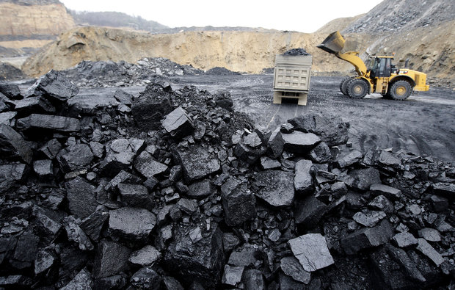
Agenda
Industry Coal Survey and Headlines
2013 Mining Company Financial Results
New & Proposed Accounting Standards

Slide 4
2012 Dean Dorton Coal Survey Central Appalachia Results
20% of operating cash costs are payroll related
17% of operating cash costs are repairs/mnt and supplies related
Other major costs include insurance, royalties, coal production taxes, purchased coal and fuel
Average sales price $79/ton
EBITDA/Ton Sold $9.67
Notes:
$5/ton enough service debt, settle networking deficits where you have extended AP and leave a return for owners?
As engineers involved in operations can help control labor, repairs/mnt/supplies costs

Slide 5
2012 Dean Dorton Coal Survey Central Appalachia Results
Cash Operating Margin 15% of Sales ($15,000,000)
Cap Ex (5%) (5,000,000)
G&A Expense (5%) (5,000,000)
Net Cash Margin 5% $5,000,000
Residual Cash Application
Debt Service
Working Capital
Income Taxes
Distributions?
Notes:
$5/ton enough service debt, settle networking deficits where you have extended AP and leave a return for owners?
As engineers involved in operations can help control labor, repairs/mnt/supplies costs

Slide 6
2013 Coal Company Headlines Patriot Coal
Continues in Chapter 11 Bankruptcy with $2 billion of liabilities subject to compromise
Lost a court verdict over legacy liabilities vs. Peabody
Plan of Reorganization to be filed on December 1, 2013
Notes:
Patriot- much of compro liab are Post retirment benefits

Slide 7
2013 Coal Company Headlines Rhino
July 22, 2013 declared a cash distribution of $0.445 per common unit
Completed acquisition of interest in Utica Shale for $25 million with an estimated 2013 cap ex of $15 million to $20 million to develop
Sold 20% of its royalty interest in Utica Shale for $10.5 million
Plans to develop coal reserves in WKY
Notes:
Patriot- much of compro liab are Post retirment benefits

Slide 8
2013 Coal Company Headlines Alpha
Major debt refinancing of approx. $1 billion
Recorded $33 million charge for loss on early debt extinguishment.
Idled mines in West VA and recorded a $22 million impairment charge
Notes:
Working capital and extend out debt terms

Slide 9
2013 Coal Company Headlines Alliance
Record EBITDA, sales volumes and revenue during 2013 enhanced by its Illinois Basin and Northern App operations
$25 million acquisition of 11.6 million proven and probable reserves in WV from Laurel Run Mining Company (CONSOL)
On July 26, 2013, declared a $1.1525 per unit cash distribution ($72.6 million)
Notes:
Alliance- strategic acquisition

Slide 10
2013 Coal Company Headlines KY Coal Severance Tax
40 Year Program
FY 2012 $298 million declined to $231 million in FY 2013
Bill outstanding to get 100% back to producing counties
Notes:
4.5% Coal Sales (net of purchased coal and transp costs)– WVA 5%
22% drop in sev funds- about same as % drop in production over past year
EKY counties suffering to balance budgets with declining sev tax revenue

Slide 11
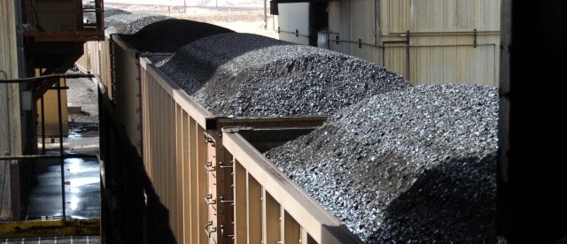
2013 Mining Company Financial Results

Slide 12
Coal Company Results per First Research
 | 2013 | 2012 | 2011
Current Ratio | 1.88 | 1.98 | 1.80
Debt/Net Worth | 1.32 | 1.20 | 1.34
EBITDA to Sales | 10.3% | 10.8% | 13.2%
Return on Sales | 2.9% | 1.8% | 4.8%
Return on Assets | 3.1% | 2.2% | 5.9%
Notes:
First Reseach obtains data from private and public coal companies
Increase in debt in 2013 as seen with Alpha
As seen in declinging cash flows EBITDA/Sales dwinding
Sales and Asset bases shrinking allowing some improvement in return%

Slide 13
Coal Company OCF* June 30, 2013 vs. June 30, 2012
#s in Thousands | 2013 | 2012 | % Change
Patriot | $(97,000) | $(59,000) | (64)%
Rhino | $29,000 | $33,000 | (12)%
Alpha | $67,000 | $135,000 | (50)%
Alliance | $374,000 | $255,000 | 47%
*Operating Cash Flows
Notes:
Operating Cash flows good indicator of company value. As we will see on next side the market has considered

Slide 14
2013 Coal Stock Results
Comp. | Curr. Stock Price* |  | 52 Week Low |  | 52 Week High | Beta
Alpha | $6.37 |  | $4.78 |  | $10.74 | 2.36
Arch | $4.73 |  | $3.47 |  | $8.86 | 2.16
Peabody | $18.00 |  | $14.34 |  | $29.84 | 2.00
*As of September 5, 2013 (Yahoo Finance) DJI Avg 14% Return Beta=Measure of Risk
Notes:
Most industries BETA are more consistent but not coal
Target- 15.3 PE
Wal Mart 14 PE (.33)
GE 17 (1.24)
GM 13 (1.69)
Micro & Apple 12 (.77)
FB 193 (3.3)
PE_ how much pay for $1 of earnings (avg market 20 to 25 times)
Alpha lost 80% of its value in past 3 years
Beta of less than 1 stable stock, moves same direction as market in whole
Greater than 1 Volatile stock subject to day to news fluctations

Slide 15
2013 Coal Stock Results
Comp. | Curr. Stock Price* |  | 52 Week Low |  | 52 Week High |  | Price/ Earn. | Beta
Consol | $33.31 |  | $26.25 |  | $37.39 |  | 61.12 | 1.86
Rhino | $12.78 |  | $12.11 |  | $17.41 |  | 15.09 | 1.49
NRP | $19.90 |  | $16.90 |  | $24.37 |  | 10.87 | 1.28
Alliance | $76.00 |  | $52.21 |  | $78.99 |  | 11.39 | 0.98
*As of September 5, 2013 (Yahoo Finance) DJI Avg 14% Return with P/E of 16.6 Beta=Measure of Risk
Notes:
Most industries BETA are more consistent but not coal
Target- 15.3 PE
Wal Mart 14 PE (.33)
GE 17 (1.24)
GM 13 (1.69)
Micro & Apple 12 (.77)
FB 193 (3.3)
PE_ how much pay for $1 of earnings (avg market 20 to 25 times)
Alpha lost 80% of its value in past 3 years
Beta of less than 1 stable stock, moves same direction as market in whole
Greater than 1 Volatile stock subject to day to news fluctations

Slide 16
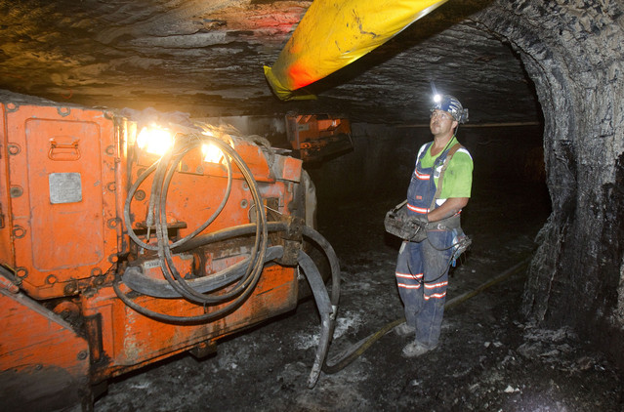
New and Proposed Accounting Standards

Slide 17
IFRIC 20 Stripping Costs in the Production Phase of a Surface Mine
IFRS- now allows capitalization of excess overburden during production process and treated as a depletable asset if can assign to a reserve base
US GAAP- costs are factored into inventory and run through expense upon sale of inventory
Notes:
Analysts with IFRS reporting mining companies should ask about this accounting change and how management adopted= should also be disclosed 2012 will need to be restated as part of the adoption

Slide 18
Emerging Accounting Issues: US Private Company Council
Formed in late 2012
Exists to bring relief to private companies from extensive GAAP accounting/reporting requirements
Currently 4 proposed “optional”relief standards
Does not apply to public companies
Notes:
Goodwill example- application

Slide 19
Emerging Accounting Issues: Leases
Excluded
Mineral, oil, natural gas leases
ST leases (less than 1 year)
“Right of Use Asset” and Lease Liability
Type A and Type B Leases
Type A will enhance EBITDA and operating cash flow presentation
Expect final draft of standard in 2013 with 2017 effective date

Slide 20
Federal Tax Change
Effective 1/1/14 new federal tangible property tax regulations take effect
Capitalization guidance including parts and supplies
Requires written capitalization policy
Please discuss with CFO soon to accommodate the major changes
Notes:
Variety of capitlaizion vs. expense practices in our industry
This change will impact book accounting as well as doubt want to keep 2 separate books

Slide 21
Reclamation Accounting Point
Catch up Contemporaneous Reclamation on active/idle jobs should be accrued at:
Year end (private)
Each quarter end (public)
End of Mine Reclamation Models do not include catch up contemporaneous liabilities

Slide 22
Accounting & Market Changes Impacting Mining Companies
Questions?
William J. Kohm, Audit Director (bkohm@ddafcpa.com)
(859 425 7625)
Notes:
We have seen through our survey, headlines and financial results the importance of controlling and reducing costs. You all have the ability to make a major impact in this endeavor and enhance your company’s value. Market volatility has enhanced your importance in providing timely and accurate data to accounting to allow for meaningful financial statements. I appreciate your time and attention and hope my comments provide value to your day to day responsibilities and heighten your awareness of actual and proposed accounting changes. At this time I will entertain any questions.

