Slide 1
Office of Surface Mining Reclamation & Enforcement (OSM)
National Issues
Regional Issues
State Accomplishments
State Issues

Slide 2
National Issues

Slide 3
Federal Rulemaking
Stream Protection Rule
The preliminary draft rule language and preliminary draft Environmental Impact Statement are currently in review at the Department of the Interior Headquarters.
Federal Register publication of the proposed rule is planned for summer 2014.
Coal Combustion Residue
Team is finalizing the NEPA document.
Federal Register publication of the proposed rule is planned for Spring 2014.

Slide 4
Federal Rulemaking
Cost Recovery Rule
Team is working on revising the rule based on the comments received.
Federal Register publication of the final rule is planned for winter 2013.
Temporary Cessation Rule
Draft proposed rule is being reviewed by the DOI solicitor’s office.
Federal Register publication of the proposed rule is planned for winter 2013.

Slide 5
OSM OVERSIGHT Evaluation Year 2013
Completed 330 joint complete inspections and 24 independent complete inspections. This is a 16% increase over EY 2012.
Monitoring Bond Adequacy address concerns raised in 30CFR 733 Letter.
Completed Joint Special Studies:
Bond Forfeitures (EY 2012)
Off-site Impacts
Inspection Frequency & Staffing Reports (2)
Fill Inventory
AMD Active Inventory
EY 2014 Performance Agreement sent out for comment to
industry on May 7, 2013- Signed on June 24, 2013.

Slide 6
AML Highlights
In addition to the excellent job of reclaiming abandoned mine sites, DAML is involved in other projects greatly beneficial to the public.
EY 2013 – Completed 19 high priority projects and submitted 71
new projects to OSM.
Completed five new projects included domestic waterline projects
for 1143 new residential customers and 524,238 feet of new waterlines at a cost of $19,707,862.
Over $112 million has been spent in prior year funding for
waterlines providing almost 14,200 households with public water
in 24 Kentucky Counties.
OSM Completed 268 AML Oversight Inspections on AML projects during EY 2013.

Slide 7
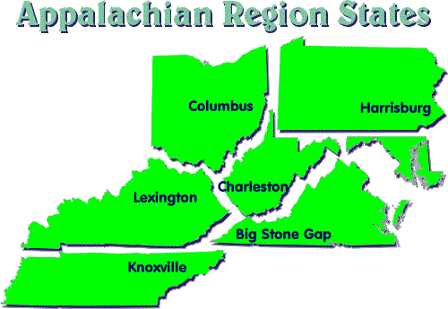
Regional Issues

Slide 8
Regional CHIA Oversight
FY 14 regional oversight by team of AR hydrologists.
Several phases in the oversight process over the next several years.
Assemble and evaluate program info by end September
Review of KY CHIA documents And supporting information during the May 2014 timeframe.

Slide 9
Regional Oversight of Slurry Impoundment Breakthrough Potential
FY 14 regional oversight by team of AR engineers.
Selection of sites based on 10% of population or about 12 sites in KY.
OSM members consist of LFO engineer, geologist and engineers from the AR, and inspectors
DNR members consist of engineers and inspectors
MSHA members include engineers and inspectors
Currently finishing VA.

Slide 10
State Accomplishments EY 2012

Slide 11
CHIA Enhancement Initiative
AD HOC working group composed of DNR, DOW, EPA, COE (Louisville district), Coal Industry, Coal Industry consultant engineer, Kentucky Resources Council, and OSM (technical representative). The first meeting was held May 11, 2009.
Kentucky Resources Council and KFTC filed a Notice of Intent to Sue on May 13, 2009 for alleged failure to perform CHIA that meets State program requirements.
DNR has made significant progress.

Slide 12
CHIA PROGRESS
July 2010 – Six CHIA Interns - completed 354 watershed characterization templates.
January 2011 – DNR announced online service that provides public access to vital watershed data. Visit EEC Website at:
http://minepermits.ky.gov/pages/CHIA.aspx
June 2011 –Established trend stations in selected HUC 12 watersheds – Phase I – 64 stations. Expanded to 137 stations in June 2012.
Sampling began – 2nd quarter of 2011 – completed four quarters (64 stations).
Interns have entered over 114,634 DMR’s and surface/groundwater monitoring and 93,000 reports into SMIS.
Future Needs – Contributions to match Federal funds.

Slide 13
Cooperative Agreements
CHIA Trend Stations (Phase III) – $119,060 (September 2012)
CHIA Study – Pigeon Roost - $15,000 (September 2012)
National Geo Mine Project - $192,000 (August 2012)
Civil Penalty Funds – Preston Slide - $218,650 (August 2012)

Slide 14
Kentucky Mine Mapping & GeoMine
Geo-referenced maps include maps of all mines operated since 1948.
Website receives over 400,000 internet queries each month and an average of 13,000 visits every day.
The GIS section has also been working on Abandoned Mined Land (AML) data. KYDNR interns worked in the AML office to extract Project Unit (PU) files and scan individual Project Area Descriptions (PAD) maps, and the accompanying data within each PU. They currently have digitized 4,806 Problem Areas, 1,779 Problem Units, 4,105 Problem Polygons, 357 Problem Lines, and 5,937 Problem Points.
Interns have been assisting with pulling paper copies of MRP maps from permit files; scanning the maps; geo-referencing the maps; and digitizing the permit boundaries. The work should be complete in the fall of 2013.

Slide 15
GIS Improvements
The GIS section reports that interns they have digitized a total of:
38,510 permitted fills (many duplicate permit numbers), and
The Permitted Mine Boundaries feature class currently stands at 20,158 polygons.
KYDNR continues to create additional digital data to address the agency’s needs, train KYDNR staff on both the applications of the software systems and the different data types that are available in the system.

Slide 16
Shared Commitment

Slide 17
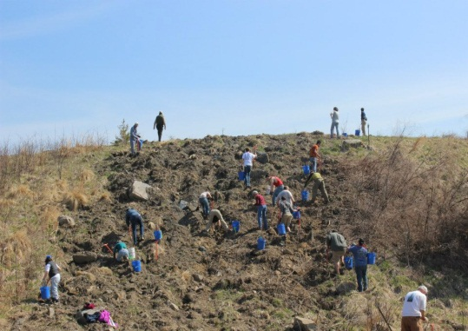
Appalachian Regional Reforestation Initiative (ARRI)
KYDNR partnered with Green Forest Works to coordinate and help volunteers plant hardwood seedlings on 16 mine sites.
Assisted approximately 521 volunteers in planting 39,810 trees on 67.58 acres.
During CY12, KYDNR granted Phase III bond release (complete release) for 2003.73 acres that had been previously planted with trees and shrubs using the FRA.
The KYDNR also granted Phase III bond release on 3560.82 acres that had been previously planted with trees and shrubs that did not use the FRA.

Slide 18
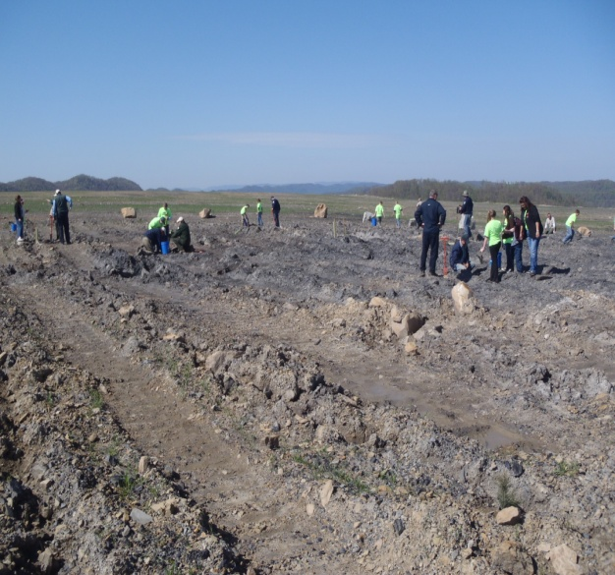
2013 Kentucky Arbor Day Celebration
J. W. Resources/Xinergy Corporation
April 26, 3013
Involved 15 students & teachers from Right Fork Elementary School in Bell County, KY DNR, OSM, mine company personnel, etc.
Planted over 550 seedlings at the Stony Fork Surface Coal Mine Complex in Bell County.
The volunteers also planted 30 Hybrid (back-crossed) American chestnut seedlings developed and supplied by The American Chestnut Foundation.
Kentucky Arbor Day Event. Right Fork Elementary students plant high value hardwood tree seedlings.

Slide 19
Interagency Coordination
Participants – EPA (Region IV), COE (Louisville and Nashville), KY DNR, DOW, KYDFW, USFWS, USGS, KY Geological Survey, and OSM LFO.
Purpose of the Meetings – Coordination and communication between agencies on issuing permits under SMCRA and Section 404 of the CWA for excess spoil fills at surface coal mining operations.
Local Interagency Coordination Agreement (LICA) signed June 20, 2012, (permit coordination).
Discussing Best Management Practices guide for operators.

Slide 20
Threatened and Endangered Species
During CY 2012, KYDNR required 30 Indiana bat surveys.
KYDNR, in coordination with the USFWS, developed 28 Indiana bat Protection and Enhancement Plans (PEP), resulting in restoration of 3,922 acres of forest.

Slide 21
State Issues

Slide 22
Bonding Adequacy
In 2011, OSM determined that Kentucky was not requiring mine operators to post adequate reclamation bonds to ensure complete reclamation of surface coal mining sites in the event that a mine operator defaulted
In May 2012, OSM initiated the 30 CFR Part 733 process, which requires the Kentucky Department of Natural Resources (DNR) to correct the bonding deficiencies or face a Federal take-over of part or all of the State’s surface coal mining program, including Abandoned Mine Land funding.
On May 7, 2012, Kentucky implemented emergency regulations that partially raised base bond rates as part of DNR’s corrective plan. On September 28, 2012, the regulations were submitted to OSM as an amendment to Kentucky’s approved surface mining program.

Slide 23
On March 22, 2013, legislation establishing a “Guaranteed Reclamation Fund,” that was signed into law.
On July 5, 2013, DNR’s submitted legislation, emergency, and implementing regulations to OSM for the creation and implementation Guaranteed Reclamation Fund.
OSM is currently processing Kentucky’s base bond program and the Guaranteed Reclamation Fund program amendments, and continuing to work with DNR to resolve identified deficiencies.

Slide 24
FLYROCK
Notes:
Done. Wendi Stephens, no change recommended, provided on 8-1-06.

Slide 25
SUMMARY OF FLYROCK EVENTS
Evaluation Year | # of Events | Description of Event
EY 2006 | 7 | Two homes damaged.
EY 2007 | 12 | Three homes, an MSHA Office & one public vehicle damaged.
EY 2008 | 16 | One fatality, one injured employee, one home, and one vehicle damaged
EY 2009 | 19 | Damages to one bridge, one house, three vehicles, cemetery fence, power substation, homes evacuated, & rock thrown onto two public roads.
EY 2010 | 12 | Damage to three homes and various properties.
EY 2011 | 5 | Damage to three homes and various properties.
EY 2012 | 3 | One rock thrown through roof of residence.
EY 2013 | 5 | Three homes and yards damaged (including roofs, and walls with near miss on a garage)

Slide 26
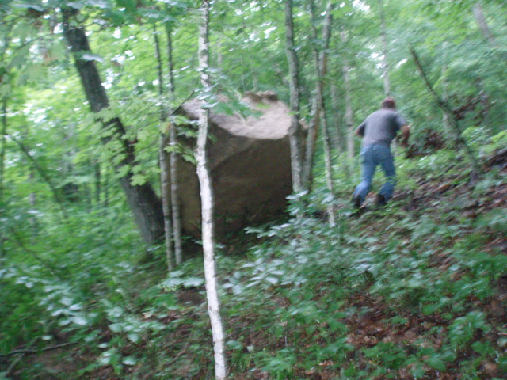
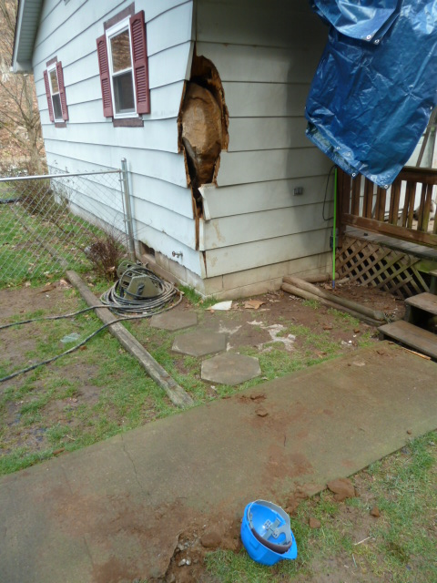
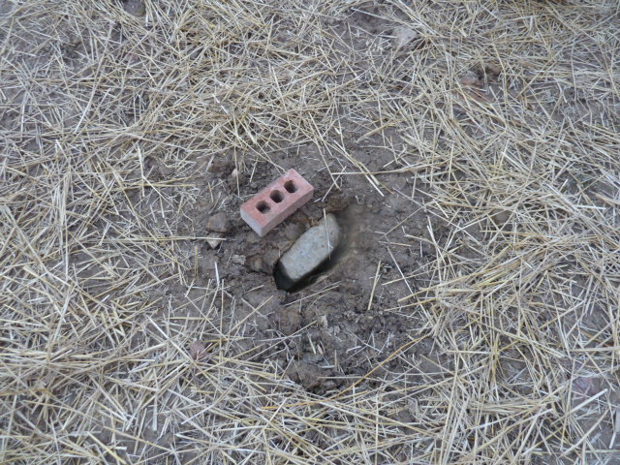
EVIDENCE OF FLYROCK EVENTS

Slide 27
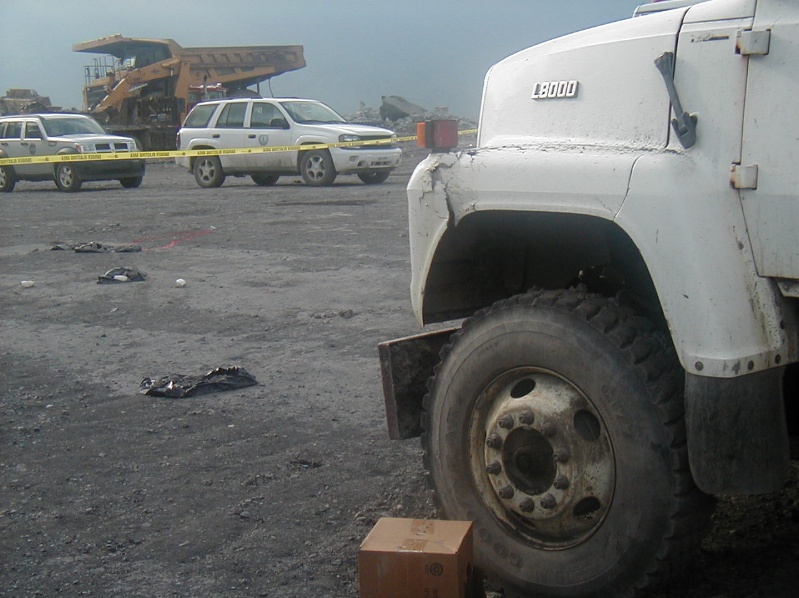
DNR Inspection Staffing
Zero Tolerance!

Slide 28
DNR Inspection Staffing
 | EY 2009 | EY 2010 | EY 2011 | EY 2012 | EY 2013
Total Staffing for DMRE | 185 | 185 | 180 | 167 | 161
Total Number of Inspectors at end of EY | 74 | 72* | 72 | 69 | 66
Inspectable Unit Per Inspector | 32 | 27 | 26 | 27 | 27
*Absorbed nine blasting inspectors from the Division of Explosives and Blasting Note In a Federal Register, OSM and DNR agreed that Kentucky’s inspection staffing level should not exceed one inspector per 24 inspectable units.

Slide 30
OSM’s History of Industry Compliance

Slide 31
Off-Site Impacts

Slide 32
Kentucky Performance Standards Cited
Significant decrease after several years of increasing

Slide 33
In EY 2013, DNR cited 1,963 performance standards in 1,081 non-compliances. Breakdown on type of performance standards is:
Percentages of Total Performance Standards Cited

Slide 34
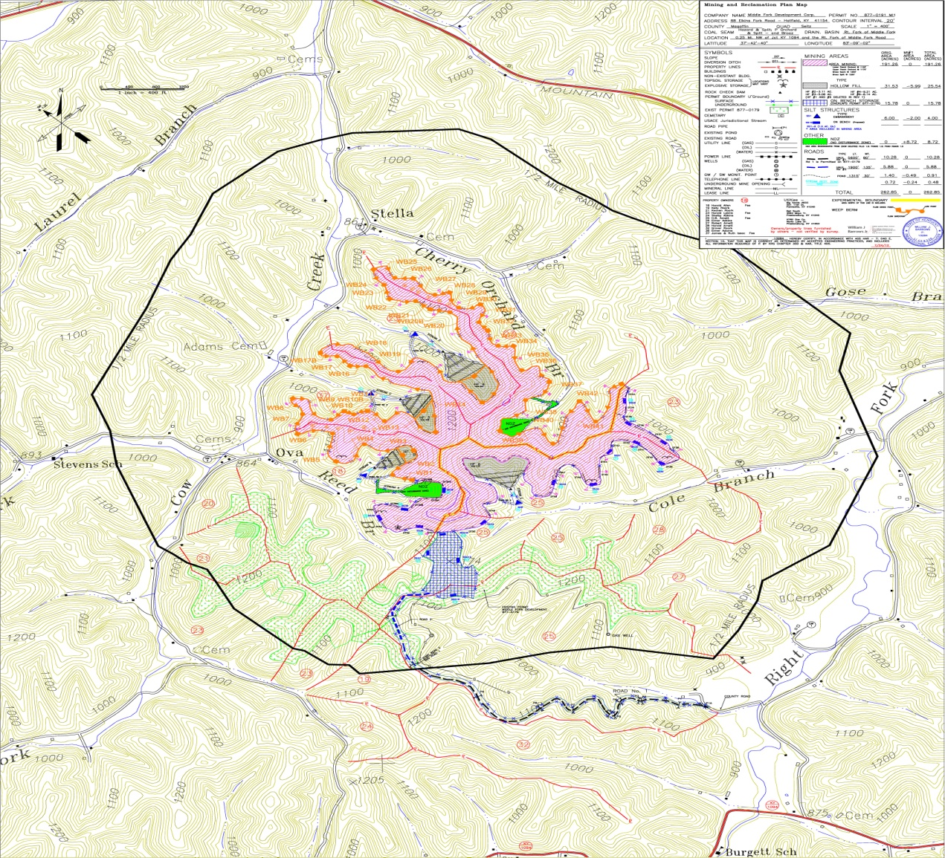
Experimental Practice: Evaluate the Performance of a Combination Sediment Ditch – Weep Berm System on Middle Fork Development Corporation permit # 877-0191

Slide 35
Looking Ahead

Slide 36
Bonding Adequacy Resolution –Meeting Conditions of the 733 Action
Blasting Oversight – Preventing Flyrock Events
Monitor Budget and Staffing
CHIA Improvements , Continuation of Trend Stations, & Regional Oversight by OSM
Slurry Impoundment Coordination with MSHA & Regional Oversight by OSM

Slide 37
Interagency Permit Coordination & EPA and COE - 402/404 Issues
Experimental Practice Dr. Richard Warner’s Concept
Issue - Expired Permits
Litigation/NOI’s
ARRI – Implement FRA Techniques where possible
GIS Improvements/GeoMine Participation

Slide 38
Thanks For Your Attention
Questions?

