Slide 1
Answering the Need for Science in Energy: The Appalachian Research Initiative for Environmental Science (ARIES)
Dr. John R. Craynon, P.E.
ARIES Project Director, Virginia Center for Coal and Energy Research, Virginia Tech, Blacksburg, VA
Kentucky Professional Engineers in Mining
September 6, 2013
Notes:
1

Slide 2
Why do we need science-based approaches?
Most issues and problems have scientific and engineering components
Scientific-based discussions allow for communication, cooperation and collaboration with all stakeholders
Optimum planning, operation and post-mining use of mining projects relies on science-based approaches
Government policies and regulations must be based on science-based solutions and practices not on politics or self-serving agendas

Slide 3
ARIES Founding
Industrial Affiliate Partners committed to fund ARIES with a grant of over $10 million
A research strategy was chartered and approved for 2011-2016
ARIES announced March 31, 2011

Slide 4
Major Research Areas of ARIES
Energy production in Appalachia
Coal mining
Natural gas
CBM
Shale gas
Electricity generation
Petroleum
Renewables
First priority focus is coal mining
Notes:
4

Slide 5
ARIES Member Companies
Alpha Natural Resources
Arch Coal
Natural Resource Partners
TECO Coal Corporation
Patriot Coal Corporation
Cliffs Natural Resources
Norfolk Southern Corporation
CSX Corporation
Coal associations are participants
In discussions with other companies interested to join
Notes:
5

Slide 6
ARIES Partner Universities
Virginia Tech
VCCER at VT is the managing entity for ARIES
West Virginia University
University of Kentucky
Ohio State University
Pennsylvania State University
University of Pittsburgh
University of Pennsylvania
Marshall University
Edward Via College of Osteopathic Medicine
Notes:
6

Slide 7
ARIES Research Team
In total, nearly 60 Academic Researchers, over 60 Graduate and Undergraduate Students, almost 30 Academic Departments representing Colleges of Engineering, Science, Agriculture, Forestry, Liberal Arts and Human Sciences, Arts and Sciences, Public Health, Business and Medicine
Notes:
7

Slide 8
Overview of “Environmental Considerations in Energy Production” Symposium
Symposium Held in Charleston, WV, April 14-18,2013
Nearly 230 attendees
Fourteen technical sessions with 70 presentations
Over 45 peer-reviewed papers in proceedings volume

Slide 9
Overview (cont.)
Abstracts of other presentations included in proceedings as well
“Environmental Considerations in Energy Production” Edited by John R. Craynon
Available from Society Of Mining, Metallurgy and Exploration
Two keynote sessions and one closing plenary
Video Greeting from U.S. Senator Joe Manchin (D., WV)

Slide 10
Keynote Session 1
Governmental view
Len Peters, Secretary, Kentucky Cabinet of environment and Natural Resources
Randy Huffman, Secretary, West Virginia Department of Environmental Protection
Conrad Spangler, Director, Virginia Department of Mines, Minerals and Energy
Karen Obenshain, Director, Edison Electric Institute
Sean Plasynski, Deputy Director, National Energy Technology Lab, U.S. Department of Energy

Slide 11
Messages from Keynote Session 1
Baseload Generation capacity Key to manufacturing
Thermal Efficiency can lower GHG Emissions
Bureaucratic IMPULSE: Manage Problems rather than Solve them
Need for research on Uranium and offshore wind
Need for regional fuel diversity in Electrical generation
CCUS Research is continuing and can benefit Appalachia through coal use and sequestration in the region

Slide 12
Keynote Session 2
Industry Perspectives
Gene Kitts, Senior Vice President, Environmental Affairs, Alpha Natural Resources
Katharine Fredriksen, senior vice president, Environmental strategy & Regulatory Affairs, CONSOL Energy
Bruce Braine, Senior Vice President, Strategic Policy Analysis, AEP Energy Services
Carl Michael Smith, Executive Director, Interstate Oil and Gas Compact Comission

Slide 13
Messages from Keynote Session 2
Scientific understanding needs to drive policy
Coal will remain critical in U.S. Energy mix
Sustainable development approaches and stewardship Are key for industry
Dealing with environmental challenges goes beyond compliance
Environmental standards may help drive future fuel mixes
Dealing with environmental challenges is key to making unconventional fuels economic and useful

Slide 14
Luncheon
Speaker: Roger Calhoun, Charleston Field Office Director, OSM
Messages:
Regulators need good science to do their job the right way
Regulators are trying to use science and technology to be more efficient and effective

Slide 15
Banquet
Speaker: Dr. Stephen Kopp, President, Marshall University
Messages:
Cooperation is key to quality, unbiased research
Universities need to look at research as a means of helping provide education

Slide 16
Closing Plenary
Speakers:
Zach Agioutantis , Technical University of Crete
Deborah Shields, Colorado State University
Peter Denton, Red River College
Messages:
Integrated management of projects requires science at the project scale
Sustainable development in mining and energy production requires involvement of stakeholders and balance of economic, social and Environmental goals
Science and sustainable development must take place within the context of conscious ethical choices

Slide 17
Technical Sessions
Watersheds
Environmental considerations in Electricity Generation
Coal Preparation
COMMUNITY well-being
Coal, Gas and Energy Production
Public Health and Energy Production
Total Dissolved Solids and Environmental impacts

Slide 18
Technical Sessions (cont.)
Landforms and geomorphic reclamation
Selenium in the environment
Stream Restoration
Stream biota impacts
Environmental Considerations in Underground Mining
Environment, Coal mining and sustainable development

Slide 19
Follow up
Planning beginning for similar meeting in 2015
New research opportunities
Half of presentations/Papers not from ARIES researchers
New connections to other ongoing work created

Slide 20
Review of some important ARIES results
Water quality
Selenium
Conductivity
Mining practices
Protection of surface water
Human health
Health disparities
Biological impairment in streams

Slide 21
Water quality
Selenium
Paul Ziemkiewicz, West Virginia University Water Research Institute
1. Selenium is a major regulatory focus under the Clean Water Act, resulting in significant costs for coal mining companies and delays in permitting
2. ARIES studies show that using a byproduct of acid mine drainage treatment may immobilize the selenium at a very low cost

Slide 22
What we already know about selenium
Between 25 and 40% of total selenium is potentially mobile
80-90% of selenium is in black shale associated with the coal seams
Its release rate is rapid (Peak concentration of Se occurs at year seven in all three studies)
Selenite is sorbed by FeOOH (a readily-available byproduct of the treatment of acid mine drainage)
Therefore:
Good case for selective handling if an economic means can be found for immobilizing most of the selenium
Hobet lysimeters were established to test whether FeOOH can immobilize selenium in the field

Slide 23
Water quality
Conductivity
Laura Kirby and John Craynon - Virginia Tech
1. Conductivity has been linked by the EPA to the health of the biologic communities in Appalachian streams and is being used as an indicator for permitting and regulatory actions under the Clean Water Act
2. There seems to be very little correlation between conductivity and VSCI scores in the Dumps Creek and Straight Creek watersheds. Data collected at different times show possible correlations that are very different from EPA regulatory guidance.

Slide 24
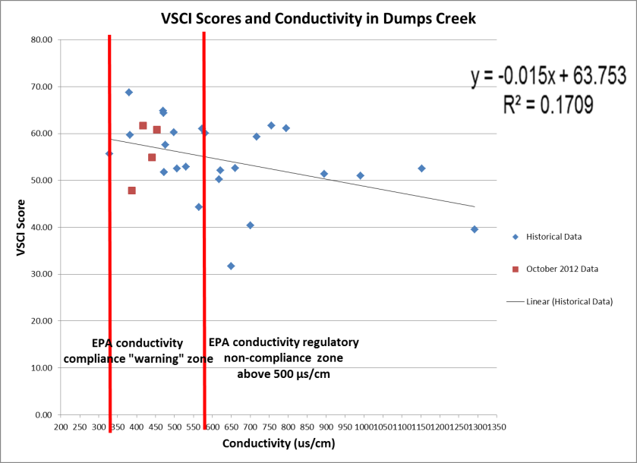
Conductivity versus VSCI scores based on historical data and VT study
No reproducible correlation between conductivity and VSCI scores

Slide 25
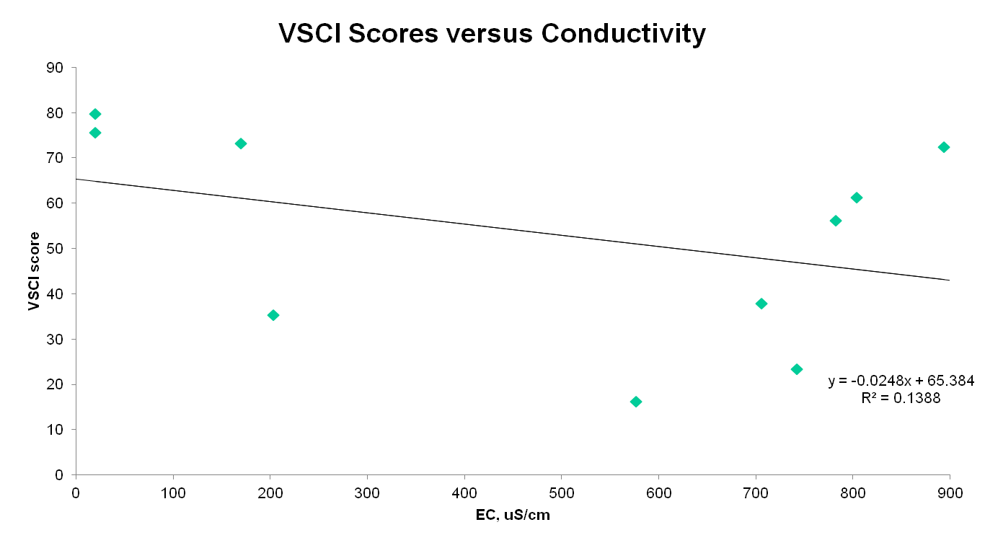
Straight Creek Data (May 2008) from Passmore and Pond, 2009

Slide 26
Improved Mining Practices
Barrier Pillars for Stream Protection in Appalachia
Michael Karmis – Virginia Tech
Zach Agioutantis – Technical University of Crete
An engineering approach has been developed under this project that can accomplish stream protection with smaller barrier pillars, as opposed to the current practice using empirical formulations.

Slide 27
Mechanism of caving and ground movements
If depth < 50t + 100ft then barrier should be left in place
If depth > 50t + 100ft then stream can be undermined
Notes:
First mining can occur in this pillar up to 50 percent extraction. For depths greater than 50t + 100ft the stream can be undermined, since an intermediate zone (Figure 4) is present and the drainage zone does not communicate with the fracture zone to allow dewatering towards the mine level.

Slide 28
Empirical Rule
Barrier pillar width (W) = 2 x (50 ft + h tan 28)
W = 432 ft [for h = 300 ft]-- (ALPS/SF=62!!
W = 472 ft [for h = 350 ft]-- (ALPS/SF=69!!

Slide 29
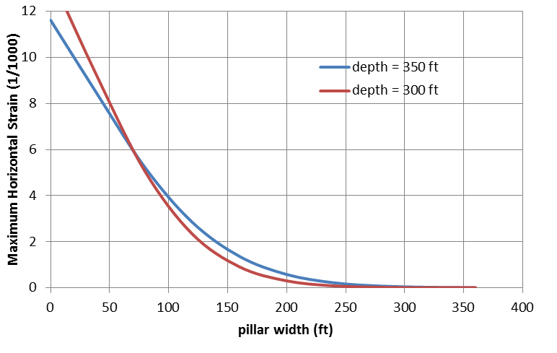
Design of Barrier Pillars Using Ground Movement Criteria, +E=10ms (impoundments)-5ms
max strain
Limit of structural damage
W=80ft, ALPS/SF=5

Slide 30
Human Health
Health disparities
Jeanine Buchanich et al. – University of Pittsburgh
1. A series of “studies” have suggested human health disparities in areas of Appalachia with coal mining
2. ARIES studies focused on independent evaluation of data and show:
- Age-adjusted mortality rates higher in mining counties across all time periods. With exception of all cause, rates are converging
- Data do not imply mining causally associated with mortality
- ARIES work points out that many confounding factors were not considered in the analyses of other “studies”

Slide 31
Specific Aim
Ecological evaluation
Compare mortality in Appalachian coal-mining versus non-coal mining counties
Examine total and select cause-specific mortality rates

Slide 32
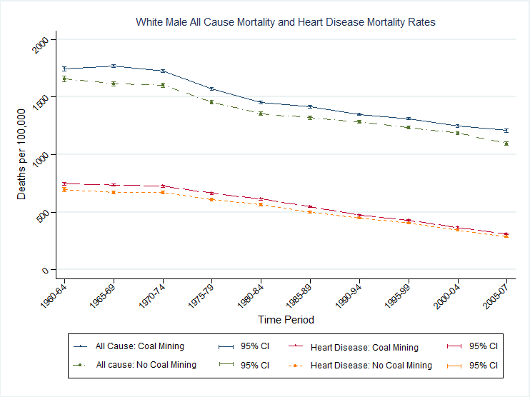
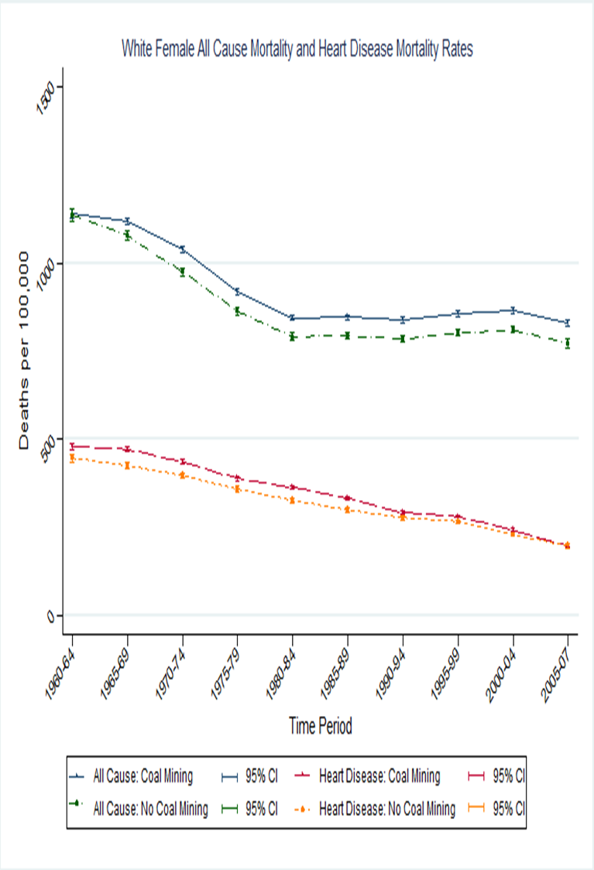
White Male Age-Adjusted Mortality Rates

Slide 33
Increased concerns about health
A number of “studies”, primarily conducted by a small group of researchers, have concluded coal mining is associated with various negative impacts on human health
The USGS has begun conducting research focused on health impacts of coal mining, including impacts from dust and water contamination
Questions about these findings
Dr. Jonathan Borak and his colleagues have questioned previous results
EPA staff recently presented on problems with research “proofiness” which misuses statistics and other analysis

Slide 34
ARIES health research emphasis
Epidemiological studies focused on determining disparities in human health among mining and non-mining counties
Analysis of exposure, bioavailability and metabolism of materials associated with mining
Analysis of exposures via dust
Analysis of other factors contributing to health issues
Lifestyle, poverty, obesity, etc.
Exposure to biocontamination (inadequate or non-existent sewage treatment)

Slide 35
Human Health
Biological impairment
Emily Sarver, Leigh-Anne Krometis and Nicholas Cook – Virginia Tech
1. ARIES study shows that there are impacts on water quality in the coal mining areas of Appalachia other than coal mining, which have the potential to create human health impacts.
- High potential for human contact with impaired water
- Great opportunity to reduce human health risk through better sewage treatment

Slide 36
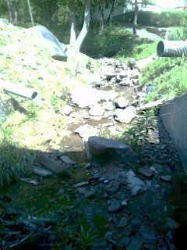
Project goals
In Central Appalachia, plenty of anecdotal evidence suggests that bacterial water impairments are huge problem
In terms of community wellbeing, we aim to:
Understand just how big the problem is
Understand what the primary contributors and potential effects are
Put this problem into context with other “high priority” water quality issues
Contribute to sustainable solutions
Notes:
Untreated/poorly treated wastewater. The practice of “straight piping” and failing septics are big problems
Photo here shows multiple straight pipes which discharge into a small creek

Slide 37
Further research needs
Current project is set to continue for another 18 months
Field data critical to connecting water quality and benthic ecology with specific discharges
Statistical analyses of geospatial data at regional- and local-scale
Clear need for extended work
Ecological and community wellbeing – what links may exist between bacterial water impairments and specific benthic and human outcomes?
Policy – how can sustainable solutions be achieved given the current inventory of stakeholders and resources?
Notes:
Would also like to get historical benthic data if available from industry.

Slide 38
Summary and Status
ARIES has already gotten meaningful results and publications in less than two years
Commitment to the program essential to get return on investment and need for new sponsors
Program of research being reviewed for efficiencies and to deal with funding levels
Consideration of expansion to utility, oil and gas, and potentially hard rock mining issues

Slide 39
ARIES Update
Second Year of research ended June 30, 2013
Third Year will be different than previous two yeas
Fewer Projects
Focus on key issues
Reflects completion of some work
Different structure
Four Emphasis Areas versus six previously
Continued expansion of health and community impacts research
Some new work to focus on new concerns

Slide 40
ARIES UPDATE (Cont.)
Re-Designed ARIES Website www.energy.vt.edu/ARIES
EMPHASIS AREAS
Emphasis Area A: Stream Protection and Restoration
Emphasis Area B: Materials characterization and handling
Emphasis Area C: Water impacts of UG coal mining
Emphasis Area D: Community and health impacts

Slide 41
Follow up
Planning beginning for ECEP 2015 symposium
New research opportunities may exist
Half of presentations/papers at ECEP not from ARIES researchers
New connections to other ongoing work created
ARIES next steps
Directing continued research and publications
Looking for opportunities for continued outreach on ARIES and results
Seeking continued and expanded support

Slide 42
Closing remarks
In difficult times, easy to remove support for research
May be more critical then to help cut costs and improve operations
The results are encouraging, but more work is needed
There is a need for broader support to ensure that the work gets done
Science will help all companies and lack of science will hurt all companies

Slide 43
What is special about ARIES?
ARIES is multi-disciplinary, multi-university, multi-priority
ARIES is independent, researcher led peer-reviewed science
ARIES was created with private resources, and is built on cooperation and communication
ARIES includes the capability to address new problems quickly (given resources)

Slide 44
ARIES
For more information:
http://www.energy.vt.edu/ARIES
Or call:
John Craynon, ARIES Project Director
(540) 231-9462 or (540) 505-3362
jcraynon@vt.edu

