Slide 1
MSHA VIOLATION AND ENFORCEMENT ISSUES
2013
KENTUCKY PROFESSIONAL ENGINEERS IN MINING SEMINAR
RWKT
Rajkovich, Williams, Kilpatrick & True, pllc
Marco M. Rajkovich, Jr.
3151 Beaumont Centre Circle, Suite 375
Lexington, Kentucky 40513
rajkovich@rwktlaw.com
859.245.1059
COPYRIGHT 2013© RAJKOVICH, WILLIAMS, KILPATRICK & TRUE, PLLC

Slide 2
Secretary of Labor v. Webster County Coal, LLC, Warrior Coal, LLC, Hopkins County Coal, LLC, River View Coal, LLC
Docket Nos. KENT 2011-1580, 2012-27, 2012-446, 2012-861, 2012-661
Location of Boreholes
30 CFR §75.1700
KRS 352.510

Slide 3
“This statute does not speak to borings which never produced natural gas or petroleum.”

Slide 4
JUDGE’S DECISION ALL CITATIONS VACATED FOR ALL OPERATIONS
Federal Law Gives No Guidance
Refused To Rely On One State’s Terminology
MSHA Had Given No Guidance
“Patently Unfair”

Slide 5
SECRETARY OF LABOR V. CLINTWOOD ELKHORN MINING COMPANY, INC., KENT 2011-546
Hubble Mining Company is operator of Hubble No. 6 Mine and Clintwood Elkhorn Mining Company, Inc. provides engineering services
Hubble No. 6 Mine is adjacent to abandoned Blackhawk Mine

Slide 6
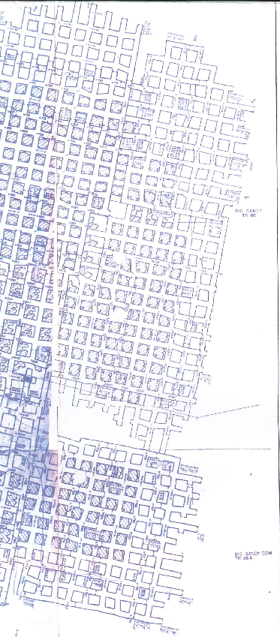

Slide 8
MSHA Issued 3 Citations
MSHA Claimed Full Extent Of Old Mine Not Shown
MSHA Claimed Hubble Mine Advanced Too Far
MSHA Claimed An Inaccurate Ventilation Map Not Up-to-date

Slide 9
Judge’s Decision
All 3 citations vacated
Mine map was accurate

Slide 10
Surveying Equipment
In the matter of Parkwood Resources, Inc., Rosebud Mining Co. v. MSHA
Case Nos. 201-MSA-1, 2011-MSA-2, 2011-MSA-11, 2011-MSA-12

Slide 11
Petition for Modification of 30 CFR § 75.507-1(a) & §75.500(d)
Use of Non-Permissible Electronic Surveying Equipment

Slide 12
Rosebud Mining Company Net Gain or Equivalence in Overall Mine Safety
Mechanical Equipment is Obsolete
MSHA Has Already Granted Petitions for Low-Voltage Equipment
Not a Significant Risk of Ignition

Slide 13
Rosebud Mining Conditions
Separate log book
Equipment examined prior to use
Equipment not used at or above 1% methane
Equipment not to be used in suspended float coal dust
Batteries changed in fresh air
Personnel training on hazards
Prior MSHA inspection
Replace or retire older equipment

Slide 14
Plan Disapprovals
Program Policy Manual V., section V.G-4

Slide 15
Mach Mining, LLC v. Secretary of Labor United States Court of Appeals For the 7th Circuit Case No. 12-3598
Stalemate on plan approval
MSHA issued technical citation

Slide 16
Arguments
Operator argued it was entitled to trial on whether plan was unsuitable
MSHA argued all that needed to be tried was whether District Manager was arbitrary and capricious
JUDGE MILLER RULED IN MSHA’S FAVOR
THE 7TH CIRCUIT AGREED

Slide 17
Mach Mining Decision
No standard of review set by Congress
Must show District Manager abused his discretion and there was insufficient evidence for the District Manager to come to that conclusion

Slide 18
Witness Stand Pointers
The “Schultz” Response
Don’t do it!
Don’t be the best witness for the opposition
If your case is a loser, convey that to your client

Slide 19
Witness Stand Pointers (cont’d)
Secretary v. Tennco Energy, Inc.
DKT No. KENT 2010-1511
MSHA claimed bad ribs and modifications needed to roof control plan
One citation and two orders were issued
ALL VACATED

Slide 20
Witness Stand Pointers (cont’d)
Photos must be identified and dated
Be mindful of other witnesses and what they saw

Slide 21
Witness Stand Pointers (cont’d) Excel Mining, LLC Cases
Dkt. No. 2010-159
Speculative sources of ignition are insufficient evidence
Dkt. No. 2010-160
Don’t jump to conclusions without evidence
Dkt. No. 2010-161
Make sure your testimony is consistent with any written documentation

Slide 22
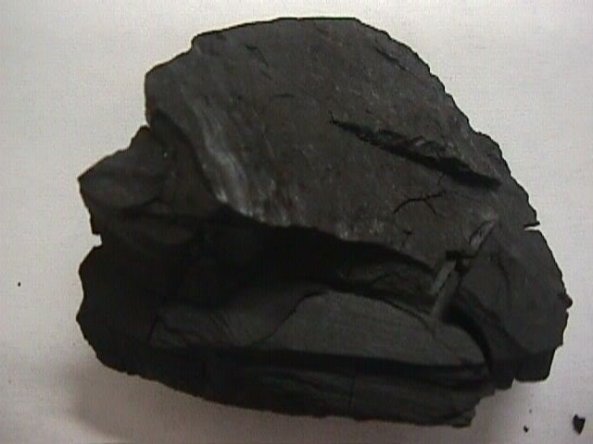
FEWER MINES
MORE COAL MINERS OUT OF WORK
and
THAT’S NOT GOOD

Slide 23
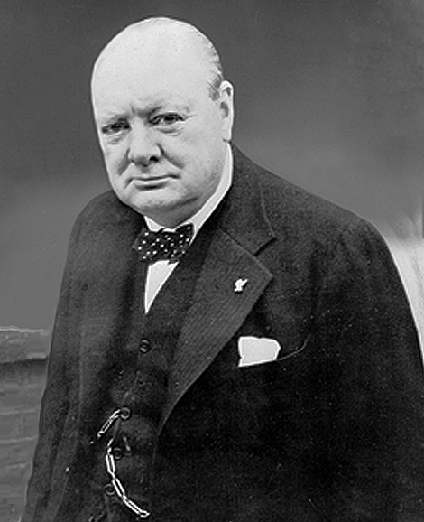
Never
Never
NEVER
GIVE UP

Slide 24
If you’re going through hell
KEEP GOING

