Slide 1
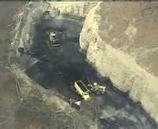
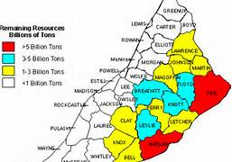
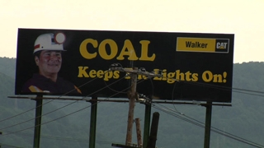
Division of Mine Permits -
Permitting Issues
PEM –September 6, 2013
Allen Luttrell

Slide 3
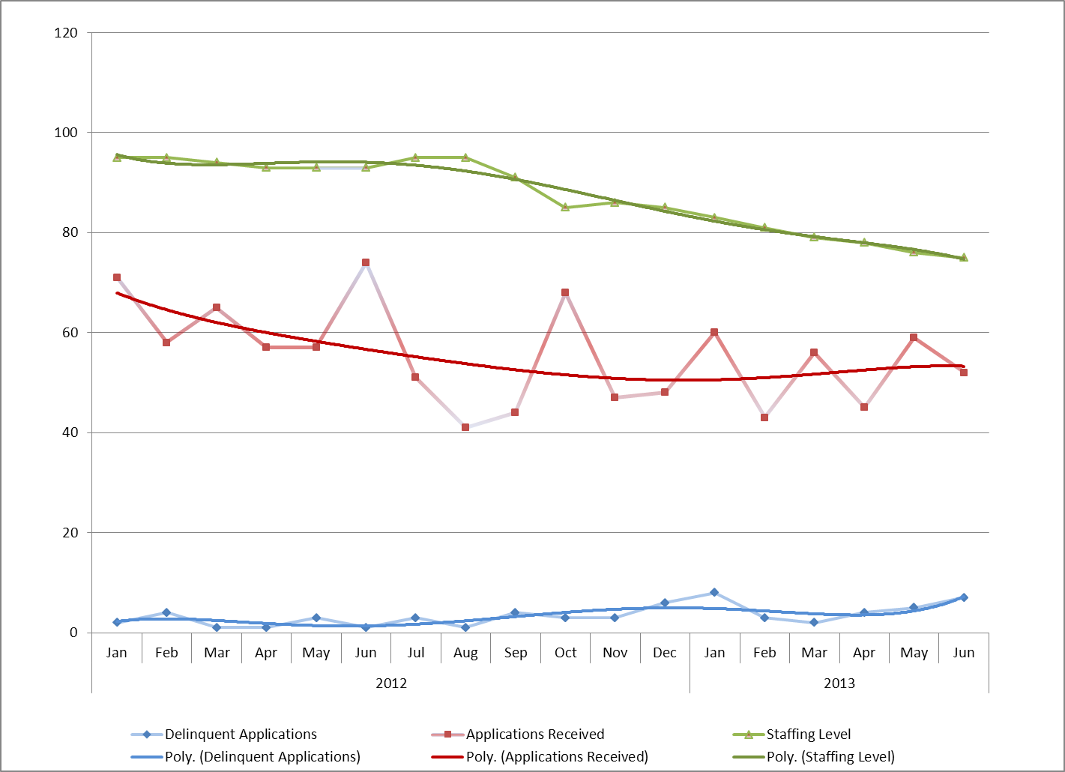
Looking at the trends for the last year and half (since January 2009)
-Applications received has decreased, but has leveled off
-Staff levels continue to decrease through June of this year
-There is a slight increase in delinquencies

Slide 4
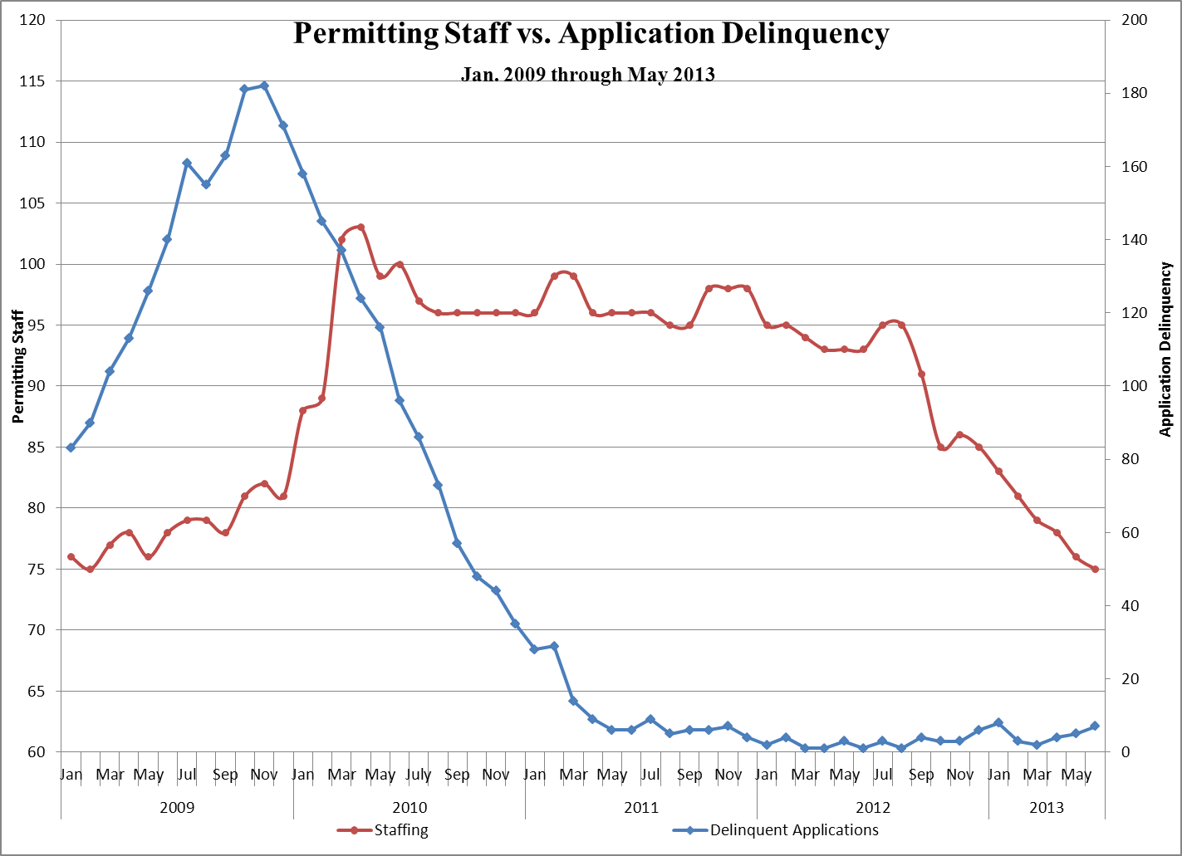
Staffing Issues
-Due to current budget constraints the Division has not been filling vacated positions, often resulting in critical vacancies.
-Over the course of the past several months permitting activity has declined. This has coincided with the decline in our staffing levels.
-Our most senior section supervisor has held that position for about three years.

Slide 5
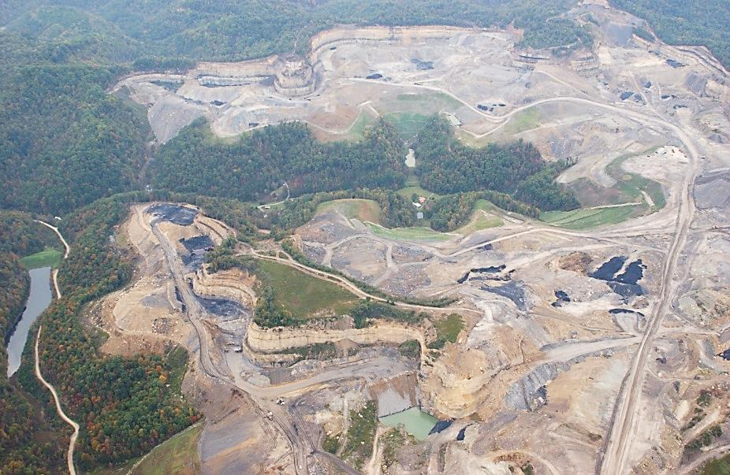
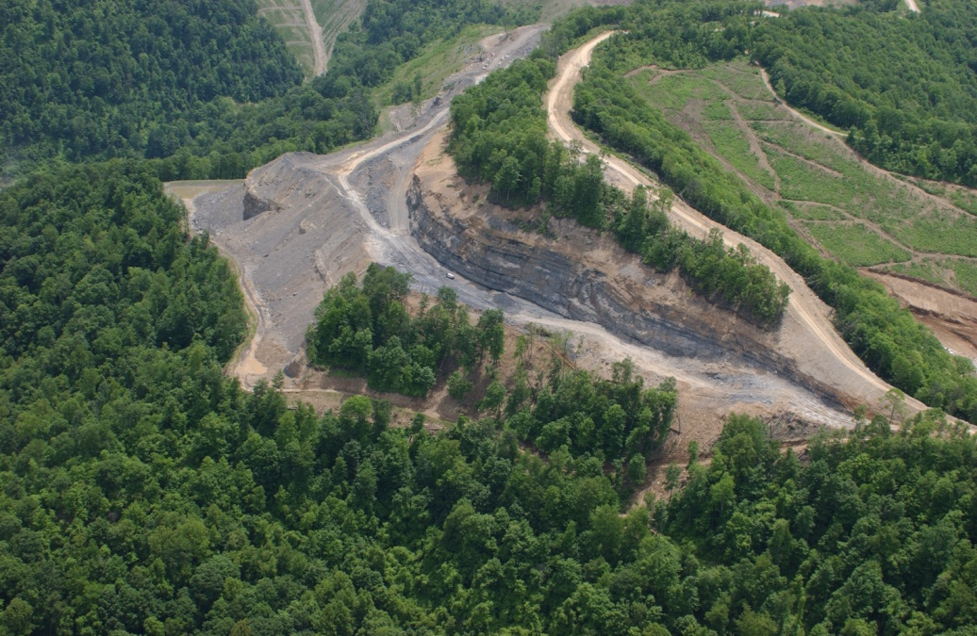
Contemporaneous Reclamation Variance
We are looking very closely at requests for contemporaneous reclamation variances.
Bonding costs for these variances have risen.
Coal Market Deferment
We presently have 33 permits in coal market deferment status.
An additional 6 applications for deferment status are pending

Slide 6
Bonding
- Mid-Terms
- Renewals
- Long-Term Treatment
Bonding is a very serious issue.

Slide 7
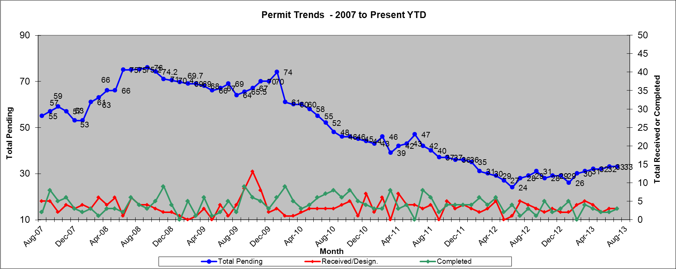
Impoundment
Oversight
Impoundment review improved substantially in the last ten years.
Most design issues dealing with stability, hydraulics and so forth have largely been worked out, and rarely result in substantial permitting delays.
Break though analysis continues to be conducted on a case-by-case basis suitable to a specific impoundment.

Slide 8
Final Pit Impoundments
MSHA asserting jurisdiction as impoundments (under 30 CFR 77.216) in some instances
Primarily when the final pit impoundment houses slurry.
These will need to be revised under the DMP review process. Certain regulations in 405 KAR apply only to MSHA class facilities.

Slide 9
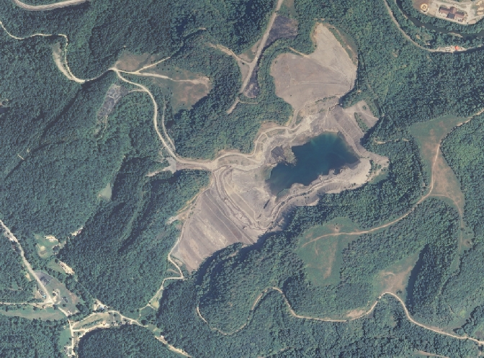
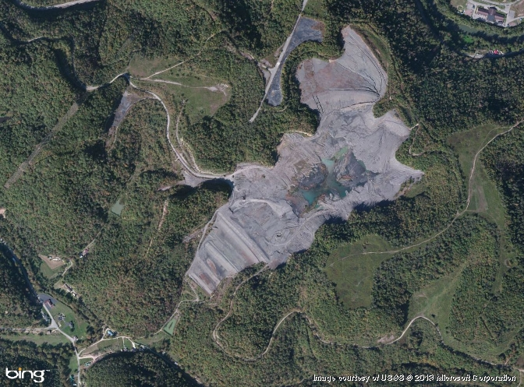
Impoundment Closure Issues
More and more impoundments are at or near the end of their operational life. We are receiving closure plans at a higher rate than ever before. The issues most often encountered are;
Availability of cover material
Heaving of slurry
Pressures within the embankment

Slide 10
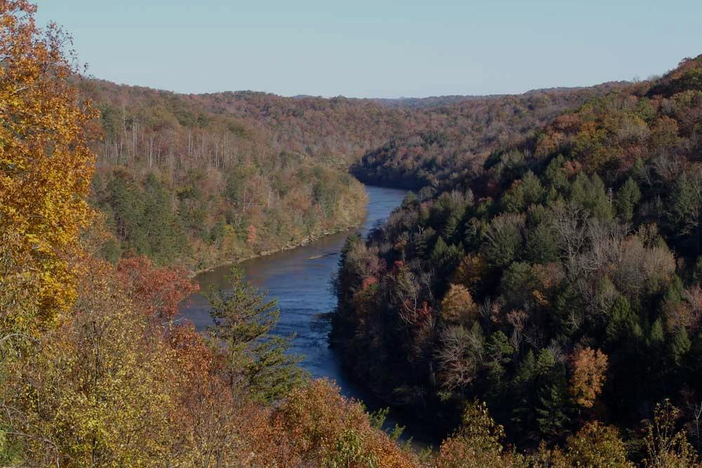
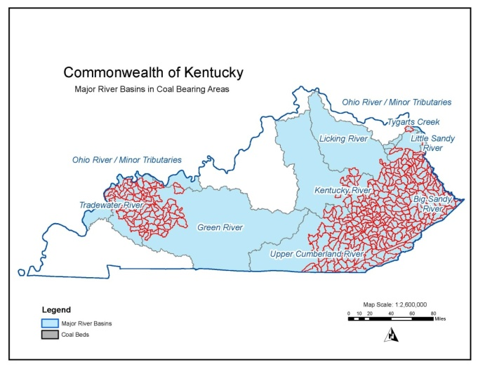
CHIA - RECENT ENHANCEMENTS
CHIA watershed reports
August 2012 – Trend station data incorporated into CHIA watershed reports.
April 2013 – Began adding AML ground-water data to SMIS for use in CHIA watershed reports.
July 2013 – Data updates automated, occur on regular schedule.
August 2013 – 368 watershed characterizations in use.
Sept 1, 2013 – 500+ CHIA watershed reports completed.
CHIA river basin reports
Quarterly reports that focus on one or more of the river basins in the coal regions
Summarizes overall water quality in the coal-mining watersheds of each river basin
Focuses on watersheds with atypical median values
NEXT STEPS:
- Augment ground water evaluation of potential impacts. - Incorporate AML data into the CHIA WS reports.
- Finalize and peer-review watershed reports - Refine analysis of water quality and mining history.
- Review and compare CHIAs from other coal-producing states.

Slide 11
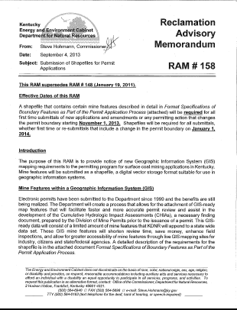
RAM # 158: Shape Files
This RAM was signed into effect on September 4, 2013, and supersedes RAM #148.
On November 21, 2013, Shape files will be required for all new application and amendments, or any new permitting action that changes the permit boundary.
After January 1, 2014, the shape files will be required for all first time submittals and all re-submittals.
Copies of this RAM are available at Division of Mine Permits or on-line at http://minepermits.ky.gov/Pages/RAMs.aspx.

Slide 12
QUESTIONS?

